Slide 1

Department of Computer Engineering
Group ID: P13
Name of Guide: Dr. Anita Shinde
Title of BE-Project: EdgeMind AI: A Privacy-Preserving On-Device Intelligent Document Assistant Using Fine-Tuned LLMs and Local RAG
Domain of Project: AI/ML
Names of Group Members:
1.Siddhi Gholap BC123
2.Arpita Ingalgi BC129
3.Onkar Kshirsagar BC133
4.Ishwari Ghatge BC164
BE Project Review1 2025-26 SEM-I

Slide 2
Department of Computer Engineering
Introduction
About Document Privacy
Confidential documents in healthcare, finance, legal, and other sectors require secure handling.
Cloud-based AI tools may expose sensitive information when documents are uploaded to external servers.
Offline AI enables document processing directly on the user's device.
About EdgeMind AI
An AI-powered, on-device document assistant that works without cloud connectivity.
Uses Large Language Models (LLMs) and Retrieval-Augmented Generation (RAG) to answer document-based queries.
Uses Explainable, context-grounded responses with relevant document references.
Incorporates security guardrails to help prevent prompt injection and data leakage.
BE Project Review1 2025-26 SEM-I

Slide 3
Department of Computer Engineering
Motivation of the Project
1. Privacy Challenges: Industries like healthcare, banking, and legal handle confidential documents that cannot be freely shared with cloud AI tools.
2. Offline Security: Running AI offline is not enough; security measures are needed to prevent malicious instructions and data leaks.
3. Industry Demand: Organizations need AI tools that can process sensitive documents securely without relying on cloud services.
4. Technical Innovation: The project combines LLM fine-tuning, document retrieval, mobile deployment, and AI security in one application.
BE Project Review1 2025-26 SEM-I

Slide 4
Department of Computer Engineering
Problem Statement
To develop an offline, privacy-preserving AI document assistant that answers questions from uploaded documents using fine-tuned Large Language Models (LLMs) and local Retrieval-Augmented Generation (RAG), providing relevant, context-based responses while protecting sensitive information through security guardrails and on-device processing.
BE Project Review1 2025-26 SEM-I

Slide 5
Department of Computer Engineering
Objective of the Project
1. Literature Survey
Study existing on-device AI assistants, LLM fine-tuning (LoRA/QLoRA), RAG techniques and security approaches to identify research gaps.
2. System Design
Design an offline Android architecture integrating document processing, local AI inference, hybrid retrieval and security guardrails.
3. Model Development
Fine-tune and quantize a lightweight LLM using LoRA/QLoRA for efficient on-device document understanding and question answering.
4. Evaluation
Test response quality, retrieval accuracy, prompt-injection resistance, privacy and on-device performance (latency, memory, battery).
BE Project Review1 2025-26 SEM-I

Slide 6
Department of Computer Engineering
Scope of the Project
Zero-Trust AI Architecture : Enable 100% on-device LLM inference with zero cloud dependency, ensuring complete data sovereignty and privacy.
Offline Intelligent Knowledge Engine : Implement Hybrid Retrieval + Offline RAG to transform local documents into an intelligent, searchable knowledge base.
Mobile-Optimized AI Platform : Deploy lightweight quantized LLMs optimized for low latency, low memory usage, and efficient smartphone performance.
Unified Multimodal AI Ecosystem : Integrate LLM, Voice, Document Understanding, and Semantic Search into a single privacy-first mobile application.
Enterprise-Ready Secure AI : Deliver a deployable solution for healthcare, legal, finance, education, and government, where confidentiality and offline accessibility are critical.
BE Project Review1 2025-26 SEM-I

Slide 7
Department of Computer Engineering
Feasibility of the Project
Cost-Effective Deployment : Fully open-source stack with no recurring API or licensing costs, enabling sustainable deployment.
Technically Feasible : Built using mature technologies such as PEFT, QLoRA, llama.cpp, Hugging Face, Google AI Edge, and Android Studio.
Privacy-Driven Solution : Operates entirely on-device, eliminating cloud dependency and ensuring complete data confidentiality.
Simple Enterprise Adoption : Requires no server infrastructure, API keys, or internet connectivity, reducing deployment complexity.
High User Accessibility : Familiar chat-based interface with document interaction and voice support, minimizing learning time and improving usability.
BE Project Review1 2025-26 SEM-I

Slide 8
Literature Survey:
Department of Computer Engineering
No. | Title / Study (Year) | Methodology / Approach | Key Findings | Evaluation Parameters | Limitations / Gaps
1 | Privacy-Preserving Medical Chatbot (2026) | Local LLM + QLoRA + GGUF for offline inference | Secure, privacy-preserving local healthcare AI | Response accuracy/quality, inference latency, memory footprint, privacy (no data leaves device) | • Medical domain only • No general-purpose AI • No hybrid retrieval
2 | Federated Adaptive Fine-Tuning of LLM with Heterogeneous Quantization and LoRA (2025) | Federated LoRA + quantization | Privacy-preserving fine-tuning | Task accuracy, convergence rate, communication cost, training time | • Training only • No standalone deployment
BE Project Review1 2025-26 SEM-I

Slide 9
Literature Survey:
Department of Computer Engineering
No. | Title / Study (Year) | Methodology / Approach | Key Findings | Evaluation Parameters | Limitations / Gaps
3 | MobiZO: On-Device Mobile Fine-Tuning via ExecuTorch (2025) | Zeroth-order fine-tuning on mobile inference engine | Efficient mobile/edge training | Fine-tuning accuracy, memory usage, training speed/runtime on device | • Training framework only • No RAG • No intelligent assistant
4 | Mobile Edge LLM Serving (2025) | Reinforcement-learning-based caching and inference offloading | Lower edge latency | Inference latency, cache hit ratio, offloading/resource cost | • Depends on edge servers • Internet required • Not fully offline
BE Project Review1 2025-26 SEM-I

Slide 10
Literature Survey:
Department of Computer Engineering
No. | Title / Study (Year) | Methodology / Approach | Key Findings | Evaluation Parameters | Limitations / Gaps
5 | MobileLLM: Optimizing Sub-billion Parameter Language Models for On-Device Use Cases (2024) | Lightweight, deep-and-thin LLM architecture for mobile | Efficient on-device inference | Zero-shot commonsense reasoning accuracy, QA/reading comprehension, chat benchmarks | • No RAG • No privacy layer • No end-user application
6 | PocketLLM: Enabling On-Device Fine-Tuning for Personalized LLMs (2024) | On-device LLM fine-tuning | Personalized mobile AI | Fine-tuning accuracy, memory consumption, training time on device | • Only fine-tuning • No document retrieval • No multimodal support
BE Project Review1 2025-26 SEM-I

Slide 11
Literature Survey:
Department of Computer Engineering
No. | Title / Study (Year) | Methodology / Approach | Key Findings | Evaluation Parameters | Limitations / Gaps
7 | Fine-Tuning of LLMs with Quantization and LoRA, i.e. QLoRA (2023) | 4-bit quantized fine-tuning using QLoRA | Low-memory LLM training | MMLU accuracy, chatbot benchmark scores (Vicuna), GPU memory footprint | • No mobile deployment • No application layer
8 | vLLM (PagedAttention) (2023) | Paged KV-cache memory management for efficient LLM serving | Faster inference and lower memory usage | Throughput (requests/s), latency, KV-cache memory waste, batch size | • Server-oriented • Not designed for smartphones • No offline assistant
BE Project Review1 2025-26 SEM-I

Slide 12
Literature Survey:
Department of Computer Engineering
No. | Title / Study (Year) | Methodology / Approach | Key Findings | Evaluation Parameters | Limitations / Gaps
9 | Retrieval-Augmented Generation for Knowledge-Intensive NLP Tasks (2020) | Retrieval-Augmented Generation (RAG) | Improved factual responses | Exact Match on open-domain QA, ROUGE/BLEU for generation, fact-verification accuracy, human factuality/specificity ratings | • Cloud-based retrieval • No offline support • No security against injected content
BE Project Review1 2025-26 SEM-I

Slide 13
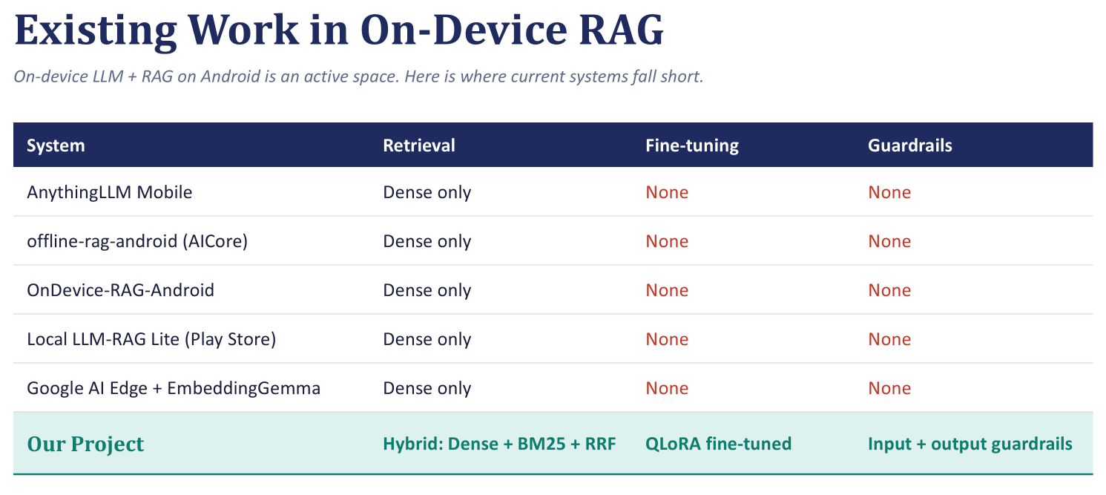
Department of Computer Engineering
BE Project Review1 2025-26 SEM-I

Slide 14
Department of Computer Engineering
Algorithm
Step 1 — Model Preparation: A lightweight LLM (~1–2B parameters) is fine-tuned using LoRA/QLoRA and quantized to GGUF INT4 format for efficient Android deployment.
Step 2 — Document Upload & Parsing: The user uploads a PDF, from which the system extracts and cleans the text.
Step 3 — Chunking & Embedding: The text is divided into overlapping chunks using a Recursive Character Text Splitter. Each chunk is converted into an embedding using a local model such as MiniLM/BGE-small.
Step 4 — Local Indexing: Text chunks, embeddings, and keyword indexes are stored locally in SQLite, making the document searchable.
Step 5 — User Query & Input Guardrail: The user submits a text/voice query. An input guardrail checks for prompt injection and out-of-scope content.
Step 6 — Hybrid Retrieval: Dense retrieval (Cosine Similarity) and sparse retrieval (BM25) run in parallel. Their ranked results are combined using Reciprocal Rank Fusion (RRF) to select relevant context.
Step 7 — Response Generation: The system combines the system instruction, retrieved context, conversation history, and query into a prompt for the quantized LLM, which generates the response token-by-token.
Step 8 — Output Guardrail & Delivery: The response is checked for leakage and scope violations, then displayed and logged locally.
BE Project Review1 2025-26 SEM-I

Slide 15
Department of Computer Engineering
Software Requirements:
Windows 11 / Ubuntu 22.04 LTS
Python 3.13.x
Kotlin 2.2.x
Android Studio Rabbit 1 (2026.2.1)
PyTorch 2.11.x
Hugging Face Transformers 5.19.0
llama.cpp 0.6.0
Android SDK, NDK and JNI (latest compatible stable versions)
SQLite 3.x
Git 2.x and GitHub
Hardware Requirements:
Intel Core i7 / AMD Ryzen 7 Processor
v5e1-TPU (Tesla T4 / RTX 3060 or higher) for model training and fine-tuning
Minimum 16 GB RAM (32 GB recommended)
Minimum 100 GB SSD Storage
Android Smartphone with Snapdragon 8-Series Processor, 8 GB RAM or higher (for mobile application testing)
BE Project Review1 2025-26 SEM-I

Slide 16
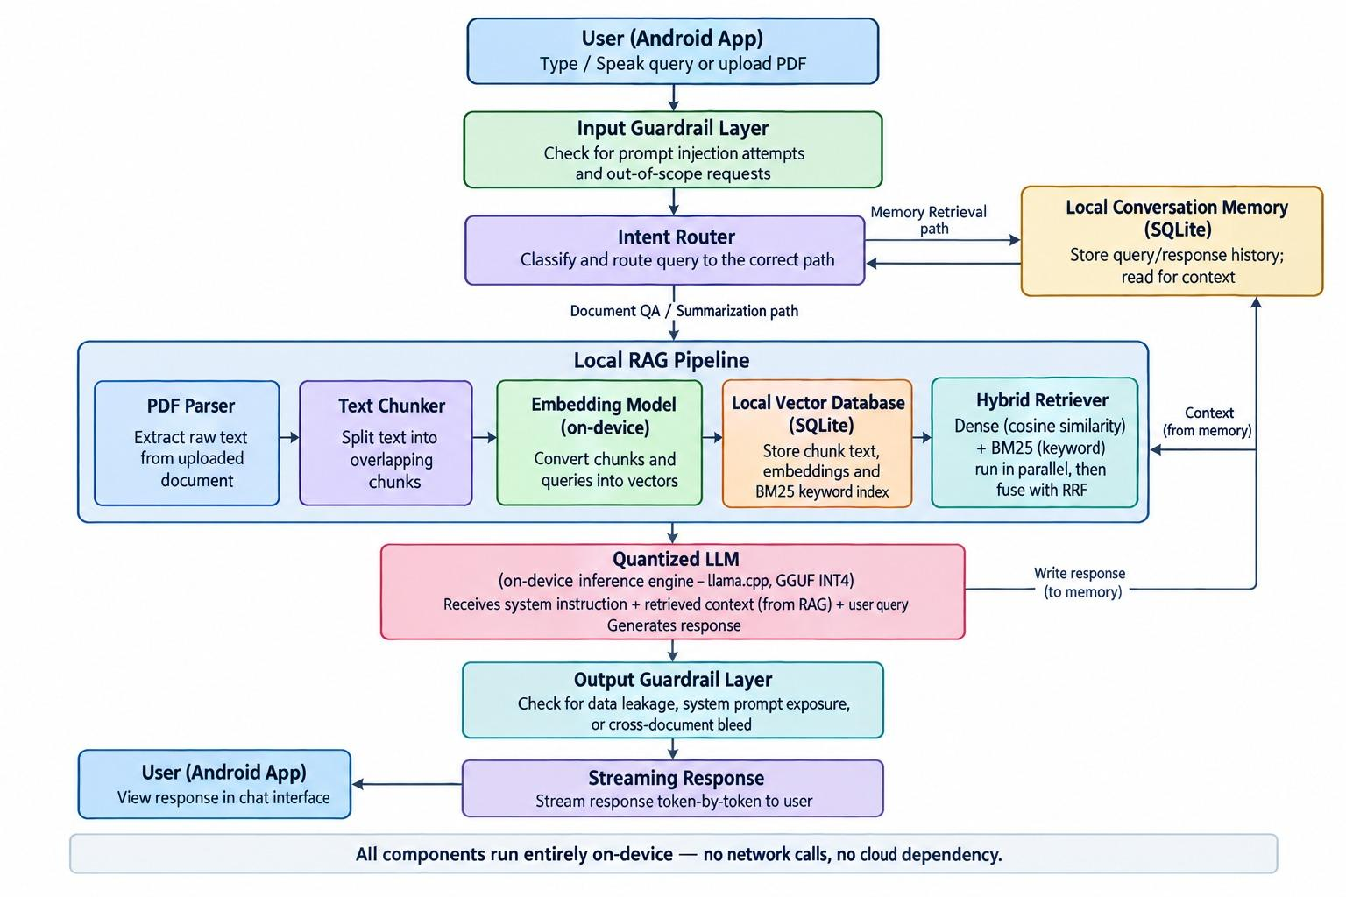
System Architecture :

Slide 17
Department of Computer Engineering
Input and Output of the Project
System Inputs:
User Query : natural language question typed by the user in the chat interface.
Uploaded Document (PDF) : reports, contracts, manuals, or statements the user wants to query.
Conversation Context : prior messages in the session, used to maintain continuity.
Voice Input (optional) : spoken query converted to text via on-device speech-to-text.
System Outputs:
Context-Aware Text Response : an answer generated by the LLM, grounded in the retrieved document content.
Source Reference : the specific document/chunk used to generate the answer, for traceability.
Streaming Response : tokens displayed progressively in the chat UI as they are generated.
Voice Output (optional) : spoken response delivered via on-device text-to-speech.
BE Project Review1 2025-26 SEM-I

Slide 18
Department of Computer Engineering
Risk Analysis Plan:
Risk | Level | Mitigation
On-device performance & memory | High | Use 1–2B model, INT4 quantization & optimize inference
Model accuracy after quantization | High | Benchmark before/after quantization and evaluate accuracy
Incorrect document retrieval | High | Use Hybrid RAG: Dense + BM25 + RRF
Privacy & data leakage | High | Input/output guardrails + encrypted local storage
PDF parsing & extraction errors | Medium | Robust parser, text cleaning, chunking & validation
BE Project Review1 2025-26 SEM-I

Slide 19
Department of Computer Engineering
References
[1] Z. Liu, C. Zhao, F. Iandola, et al., “MobileLLM: Optimizing Sub-billion Parameter Language Models for On-Device Use Cases,” Proceedings of the 41st International Conference on Machine Learning (ICML), PMLR, vol. 235, pp. 1–24, 2024.
[2] D. Peng, Z. Fu, J. Wang, et al., “PocketLLM: Enabling On-Device Fine-Tuning for Personalized LLMs,” Proceedings of the Fifth Workshop on Privacy in Natural Language Processing (ACL Workshop), pp. 91–96, Aug. 2024.
[3] T. Dettmers, A. Pagnoni, A. Holtzman, and L. Zettlemoyer, “QLoRA: Efficient Finetuning of Quantized LLMs,” Advances in Neural Information Processing Systems (NeurIPS), 2023.
[4] E. Hu, Y. Shen, P. Wallis, et al., “LoRA: Low-Rank Adaptation of Large Language Models,” International Conference on Learning Representations (ICLR), 2022.
[5] P. Lewis, E. Perez, A. Piktus, et al., “Retrieval-Augmented Generation for Knowledge-Intensive NLP Tasks,” Advances in Neural Information Processing Systems (NeurIPS), vol. 33, pp. 9459–9474, 2020.
[6] W. Kwon, Z. Li, S. Zhuang, et al., “Efficient Memory Management for Large Language Model Serving with PagedAttention,” Proceedings of the ACM Symposium on Operating Systems Principles (SOSP), pp. 611–626, 2023.
[7] Z. Gao, Z. Zhang, Y. Guo, and Y. Gong, “Federated Adaptive Fine-Tuning of Large Language Models with Heterogeneous Quantization and LoRA,” IEEE INFOCOM 2025 – IEEE Conference on Computer Communications, 2025.
[8] L. Gao, A. Ziashahabi, Y. Niu, et al., “MobiZO: Enabling Efficient LLM Fine-Tuning at the Edge via Inference Engines,” arXiv preprint arXiv:2409.15520, 2025.
BE Project Review1 2025-26 SEM-I

Slide 20
THANK YOU!!!
Department of Computer Engineering
BE Project Review1 2025-26 SEM-I

